Slide 1
Reinforcement Learning in Quadrotor Helicopters

Slide 2
Learning Objectives
Understand the fundamentals of quadcopters
Quadcopter control using reinforcement learning
Notes:
Learning about quadcopters will help us identify what are possible, states, actions and rewards

Slide 3
Why Quadcopters?
It can be used in various applications.
It can accurately and efficiently perform tasks that would be of high risk for a human pilot to perform.
It is inexpensive and expandable.
Notes:
Quadcopter is growing interest in research organizations because…
- Applications: Search/rescue, military applications, traffic surveillance, film, photography, and Research!
Expandable technologies: Vision, GPS, gyros, accelerometers, magnetometers, barometers, etc.
Currently, most of the focus on quadcopter research is designing autonomous quadcopters.

Slide 4
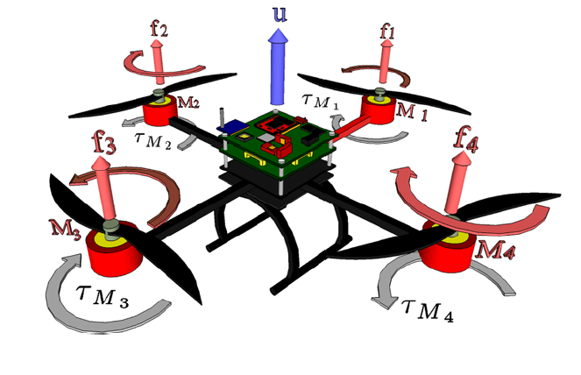
Quadcopters Specs
Notes:
VTOL (vertical take off and landing ability
A typical quadrotor wil have:
Interial measurement unit (IMU)
Electronic Speed Controllers (ESCs)
microcontroller
4 rotor aircraft with fixed pitch blades (2 sets of counter rotating blades)
~15 min flight time

Slide 5
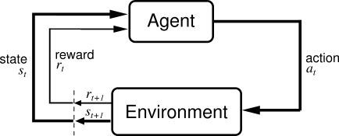
Quadcopter as an Agent
What are possible actions of a quadcopter?
What are possible states of a quadcopter?

Slide 6
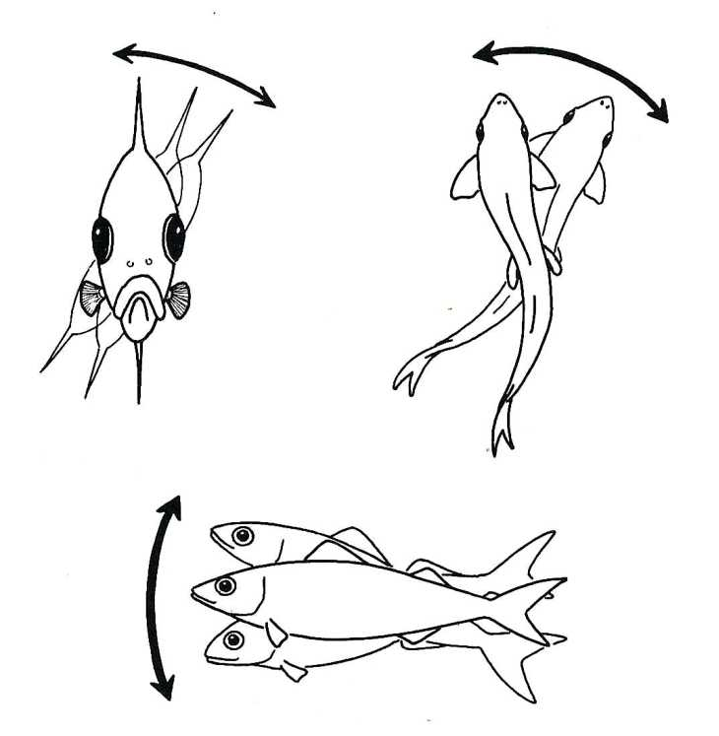
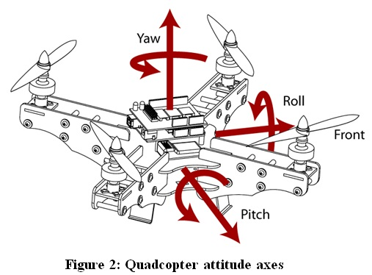
Actions: Roll – Pitch – Yaw – Throttle
Notes:
4 inputs allow independent actuation of pitch, roll, yaw and thrust

Slide 7
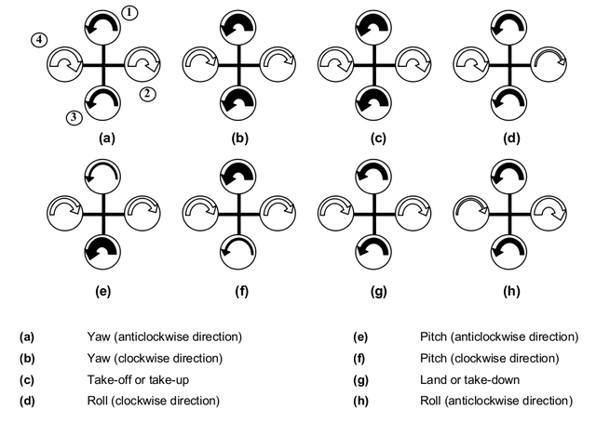
How Quadcopter maneuvers?
Notes:
The roll, pitch, yaw of a quadrotor changes depending on the throttle in each rotor. (Discuss the diagram)
The vehicle has two different configuration in which it can be flown, the X configuration and the ‘+’ configuration
(An X-configuration is considered to be more stable compared to + configuration, which is a more acrobatic configuration)

Slide 8
States
Position of the quadcopter in the environment.
Current sensor reading
Inertial measurement unit (IMU)
Accelerometers, gyroscopes, magnetometers
Barometer (altitude)
GPS (location)
Ultrasonic sensors
Cameras
Notes:
Various types of input systems have been used for controlling the quadrotor in specific ways. Two major types of are those employing on-board camera systems, and those employing off-board camera systems.
IMUs is an electronic device that measures and reports on a craft’s velocity, orientation, and gravitational forces, using accelerometers, gyroscopes and sometimes magnetometers.
IMUs are used to maneuver aircraft. IMU’s work by the detecting the changes in pitch, roll and yaw
Importance of IMU in RL and autonomy. Data reported by the IMU is fed into a computer. Example, if an IMU in a quadcopter were to detect that the aerial vehicle traveled westward for 30 minutes at an average speed of 25 mph, then the computer would deduce that the plane is around 12.5 miles west of its initial position. This method of navigation is called dead reckoning.
Major disadvantage of using IMUs for navigation it typically suffer from accumulated error. Barometers and magnetometers increases stability and autonomy.
Barometer
GPS
Ultrasonic range sensors use for low level altitude control and obstacle avoidance. Generally used for quadrotors to hover at a certain height or need to fly in an indoor environment where it has to detect obstacles. (can infrared or a laser range finder)
States also depends on the problem you are trying to solve.
(NOT INCLUDED:
Accelerometer measures the orientation of the quadrotor with respect to earth
Why we need gyro? Because accelerometer cannot sense rotation and only gives readings assuming the platform is stationary
Gyro has the ability to measure the rate of rotation around an axis

Slide 9
Multi-Agent Quadrotor Testbed Control Design: Integral Sliding Mode vs. Reinforcement Learning
Problem with altitude control
Highly nonlinear and destabilizing effect of 4 rotor downwashes interacting
Noticeable loss in thrust upon descent through the highly turbulent flow field
Other factors that introduce disturbances, blade flex, ground effect and battery discharge dynamics
Additional complication arise from the limited choice in low cost, high resolution altitude sensors.
Notes:
We will focus more on the reinforcement learning aspect of this paper.
Although this was an old paper, this is quite relevant as there isn’t much paper written on application of reinforcement learning in quadrotor which opens to a lot of opportunity for research
In this paper,
In 2005, it compares control design techniques, specifically for outdoor altitude control, in and above ground effect
Due to complex airflow induced by the four interacting rotors, classical linear techniques failed to provide sufficient stability
ISM and RL control are presented as two design techniques for accommodating the nonlinear disturbances.
The ultrasonic ranging device used suffered from false echoes and dropouts. The raw data stream includes spikes and echoes that are difficult to mitigate
ISM takes the approach that the disturbances CANNOT be modeled. Instead designs a control law that is guaranteed to be robust to disturbances as long as they do not exceed a certain magnitude.
While model-based RL creates a dynamic model based on recorded inputs and responses, without any knowledge of the underlying dynamics, and seeks optimal control law.

Slide 10
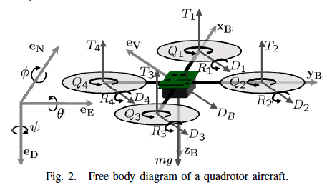
Quadrotor Dynamics
Notes:
Quadrotor dynamics is in North-East-Down (NED) inertial and body fixed coordinates.
{eN, eE, eD} denote the inertial axes
{xB, yB, zB} denotes the body axes
{\phi, \theta, \psi} with respect to the eN, eE and eD, are referred to as roll, pitch and yaw respectively
Let r be defined as the position vector from the inertial origin to the vehicle center of gravity (CG)
Let \omegaB be defined as the angular velocity in the body frame
eV is the current velocity direction in inertial coordinates
Qi (torque), Ti (thrust), u(i) voltage applied to the motors

Slide 11
Reinforcement Learning Control
A nonlinear, nonparametric model of the system is constructed using flight data, approximating the system as a stochastic Markov process
A model-based RL algorithm uses the model in policy-iteration to search for an optimal control policy
Notes:
First, a nonlinear, nonparametric model of the system is first constructed using flight data, approximating the system as a stochastic Markov process
A model-based reinforcement learning algorithm uses the model in policy-iteration to search for an optimal control policy

Slide 12


Step 1: Model the aircraft dynamics as a Stochastic Markov Process
V - is the battery level
u - is the total motor power
r_{z} - altitude
v - is drawn from the distribution of output error as determined by maximum estimate of the Gaussian noise in the LWLR estimate
m training data points, training samples are stored in X, and outputs stored in Y
Notes:
- Use Locally Weighted Linear Regression (LWLR) approach is used to map the current state and input onto the subsequent state estimate
(NOTE: r be defined as the position vector from the inertial origin to the vehicle center of gravity (CG))
Column of 1s in X enables the inclusion of a constant offset in the solution, as used in linear regression

Slide 13



Cont. step 1
Using value decomposition, thus, the stochastic Markov model becomes
Notes:
The diagonal weighting matrix W, acts on X, has one diagonal entry for each training data point. That entry gives more weight to training data points that are close to the S(t) and u(t) for which S(t+1) is to be computed.
The distance measure used in this work is Wi,I
Where x^I is the ith row of X
Fix parameter \tau is used to adjust the range of influence of training points (can be tuned by cross validation to prevent over or under fitting the data)

Slide 14

Step 2: Model-based RL incorporating the stochastic Markov model
c1 > 0 and c2 > 0 - are constants
S_{ref} - is reference state desired for the system
π(S,w) - control policy
w - is vector of policy coefficients w1,…,w_{nc}
What additional terms could be included to make policy more resilient to differing flight conditions?
Notes:
C1, c2 for accurate tracking and good damping

Slide 15
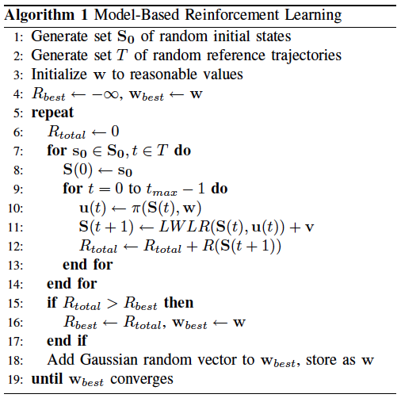
Model-Based RL Algorithm
Notes:
Aim is to find the value of w that yields the greatest total reward R{total}
In policy iteration, a fixed set of random initial conditions and reference trajectories simulate flights at each iteration, with a given policy parameterized by w
After every iteration, a new value of w is stored as w{best} if it outperforms the previous best policy, by comparing Rtotal to Rbest
Then a Gaussian random vector is added to wbest., result is stored in w
This is iterated until wbest remains fixed for an appropriate number of iterations.

Slide 16
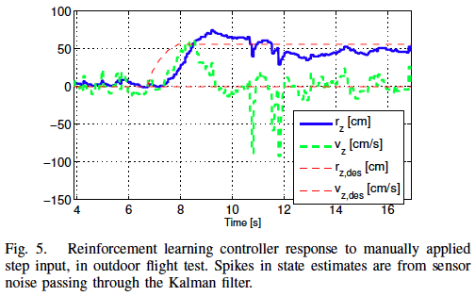
Results
Notes:
One of the most exciting aspect of RL control design is its ease of implementation. The policy iteration algorithm arrived at the implemented control law after only 3 hours on Pentium IV computer.

Slide 17
Other Examples
Balancing a Flying Inverted Pendulum https://www.youtube.com/watch?v=oYuQr6FrKJE&noredirect=1
Automated Aerial Suspended Cargo Delivery through Reinforcement Learning https://www.youtube.com/watch?v=s2pWxgAHw5E&noredirect=1

Slide 18
References
S. Gupte, P.I.T. Mohandas, and J.M. Conrad. A Survey of Quadrotor Unmanned Aerial Vehicles.
S.L. Waslander, G.M. Hoffmann, J.S. Jang, and C.J. Tomlin. Multi-Agent Quadrotor Testbed Control Design: Integral Sliding mode vs. Reinforcement Learning

